Slide 1

Trivia game with WCF
Group 6
George Vasileiadis
Todor Tsekov
Lin Jiefan

Slide 2
Agenda
The game
Architecture
Class diagram
Demo

Slide 3
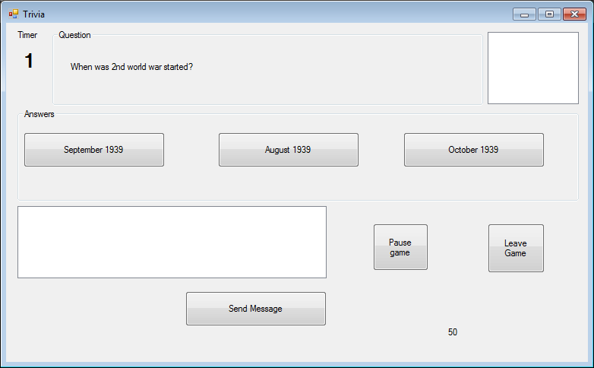
The game

Slide 4
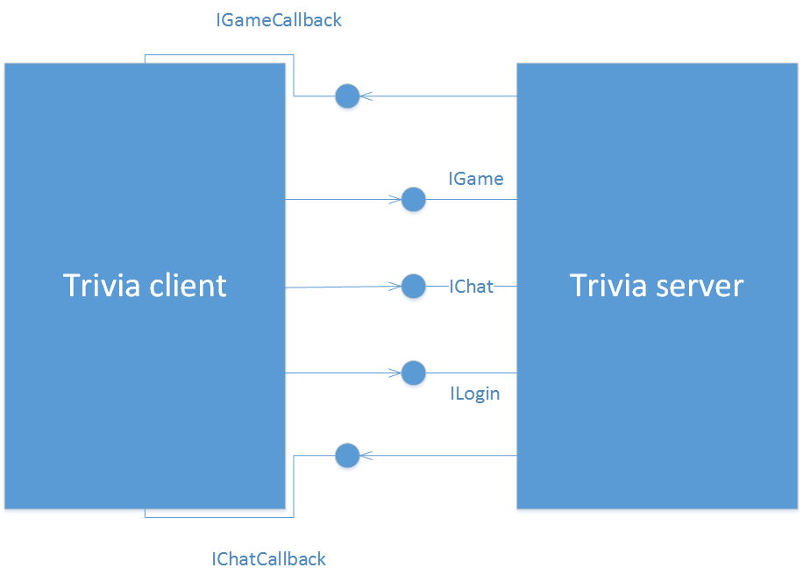
Architecture

Slide 5
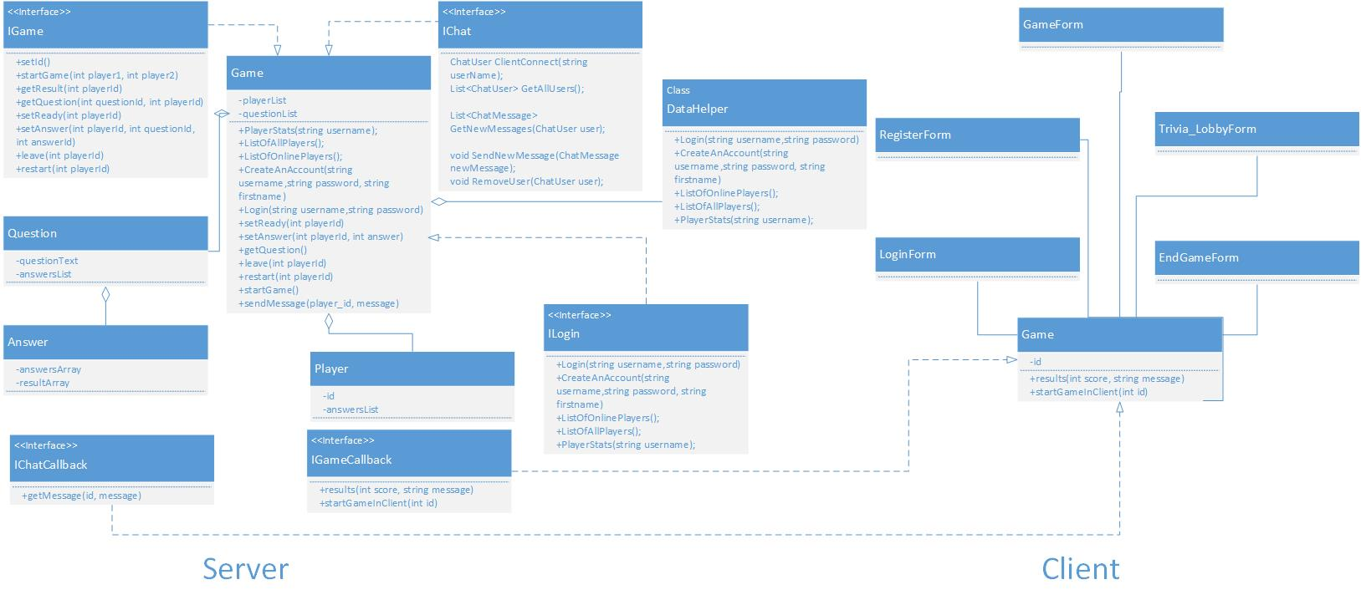
Class diagram

Slide 6
Demo time!

